Slide 1
Black Friday
ECON3321
Kehan Chang

Slide 2
PART.01
Data Description

Slide 3
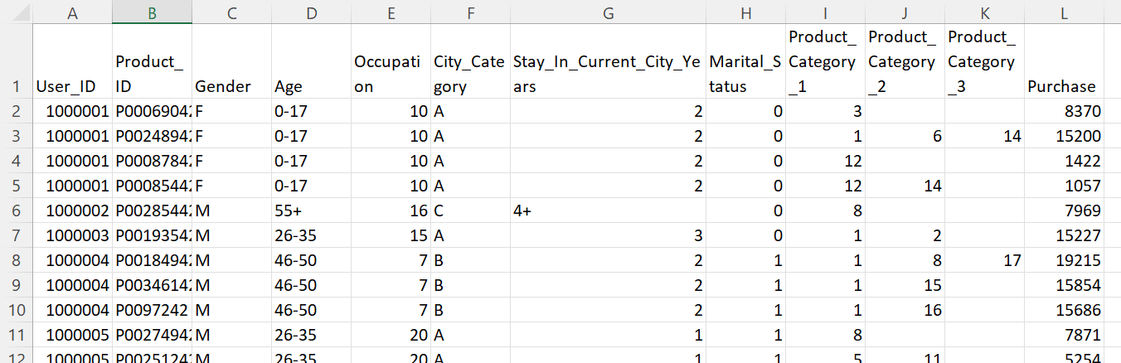
PART.01
introduction
User’s ID (different consumers)
Gender/ Age/ Occupation/City / The Time They Stay In/ Marital Status
Products Category/Purchase Amount
Notes:
One row means one transaction that the consumer made in different t series , and One user’s ID represents one consumer

Slide 4
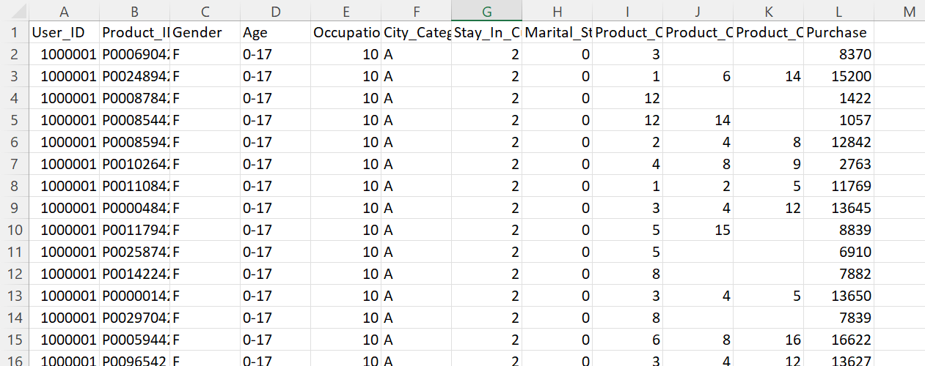
PART.01
introduction
Products & Purchase
Multiple transactions of one user’s ID
Personal information
more transaction ≠ more consumers ≠ large purchase amount

Slide 5
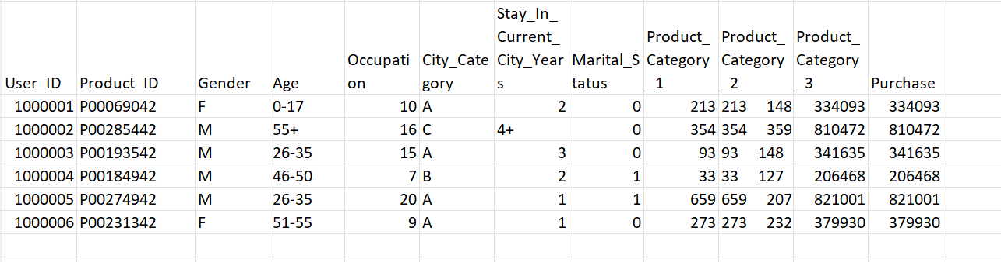
Each row represent one consumer
Corresponding personal information
Total purchase amount + products

Slide 6
PART.02
Data Analysis

Slide 7
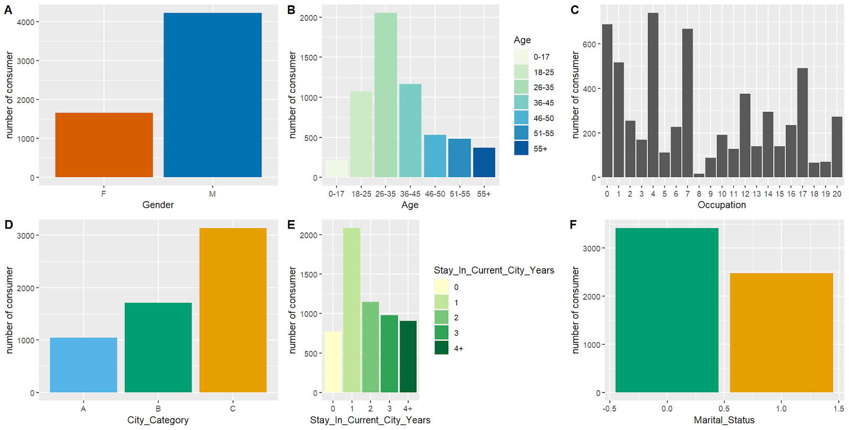
Consumer Profile

Slide 8
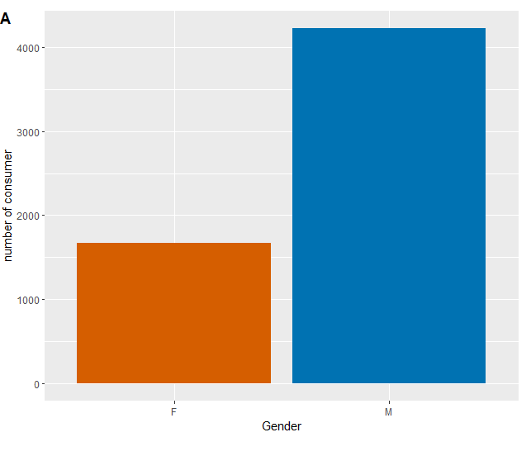

Genders
The number of consumers
The average purchase amount
More male consumers ≠ they buy more.
→>A higher proportion of the male in the total population
Notes:
we can comparing more data to test whether this assumption is true

Slide 9
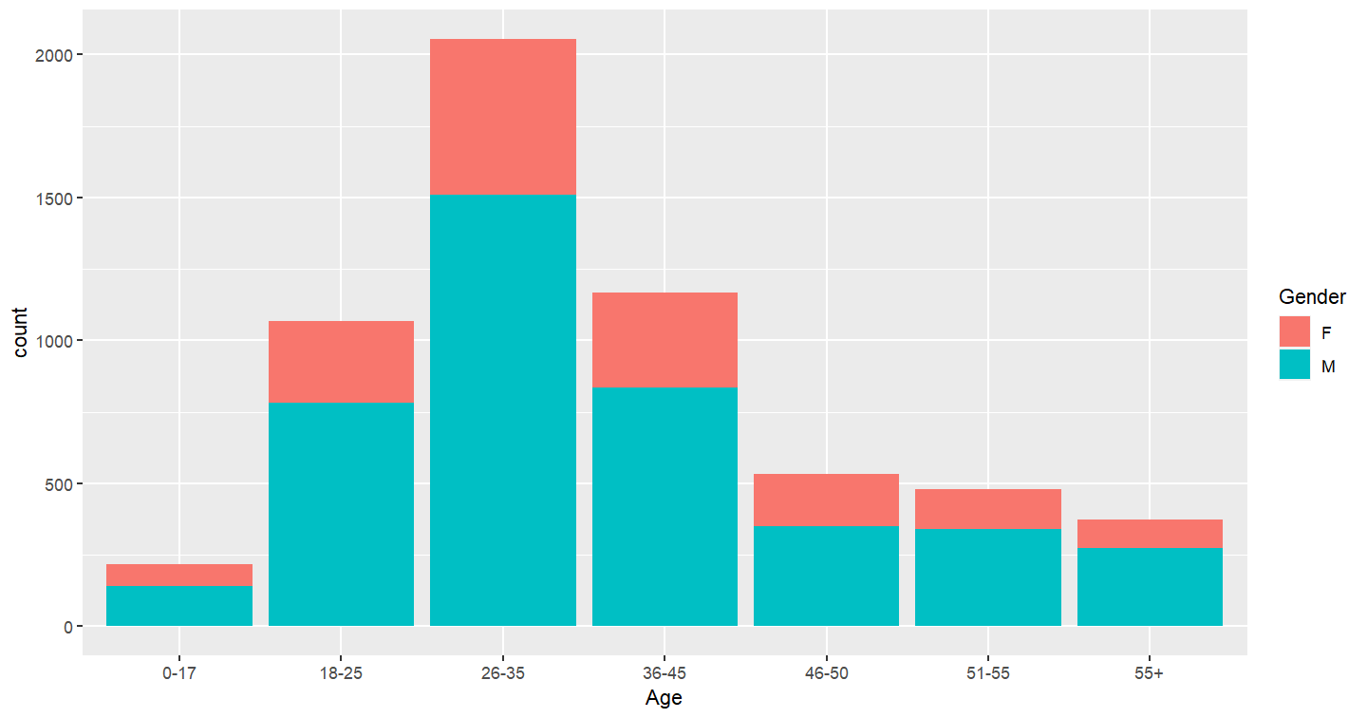
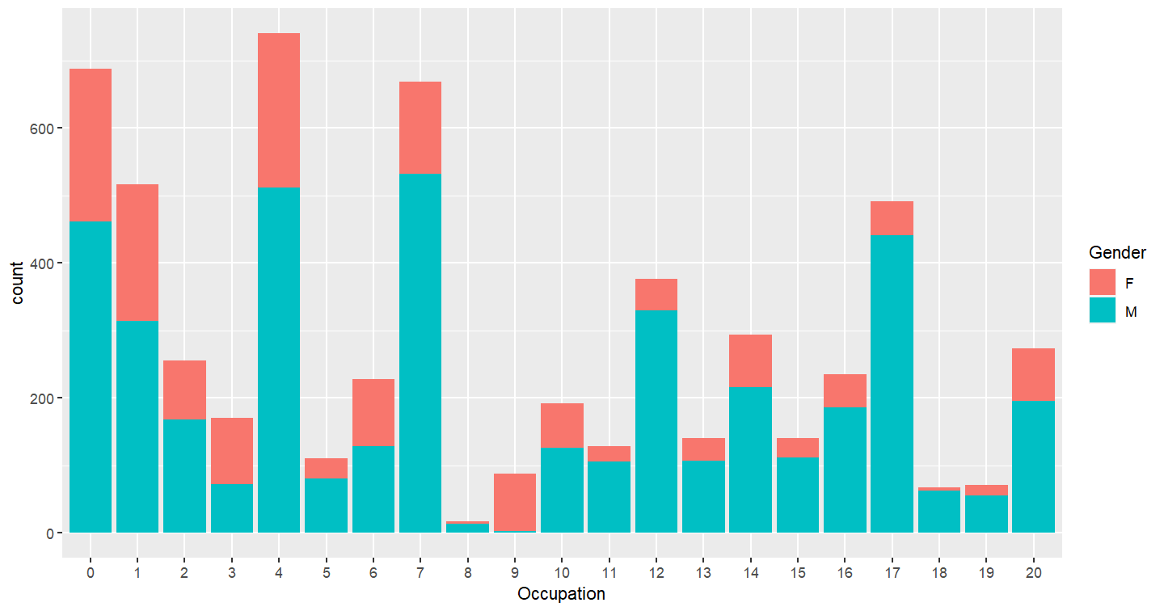
For the number of consumer individual :
*Gender distribution in the Different Age intervals
In the different occupations

Slide 10
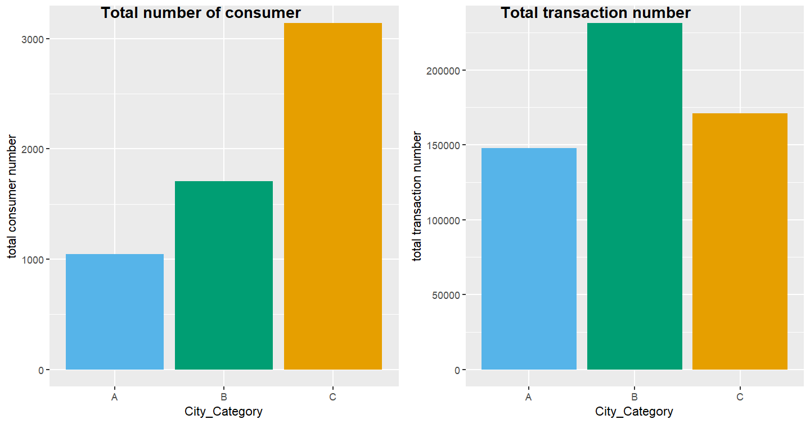

City Categories
City C has the largest consumer numbers; but B got the largest transaction number and purchase amount
→>B purchase more frequently, but less individual consumers participated in the black Friday compared to the city c
→>city B has a more prosperous economy or more citizens advocate for consumerism
city C has a larger population base
Notes:
Certain group of consumers does not mean they buys more, we can also see this trend in city category.

Slide 11
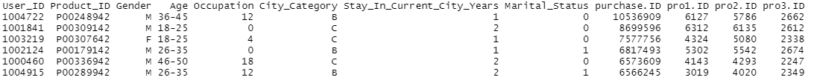

Top Buyers:
Consumers who have the largest purchase amount
Best sellers:
Product’s ID appearing the most among all the transactions
Notes:
After analyzing what the consumer group look like, who spend the most would be the topic we want to know

Slide 12
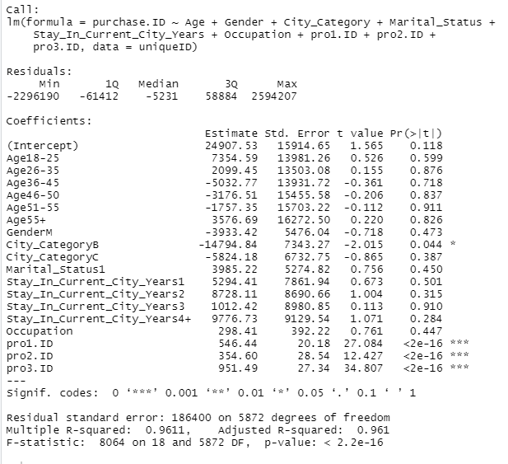
Regression Analysis
P-value:
P < 0.05 --City B
P < 0.0001 –Pro1,2 &3
R-squared: 0.961

Slide 13
Q&A
1PPT.COM

